Slide 1
Maths of Celtic and African art
Chris Budd OBE

Slide 2
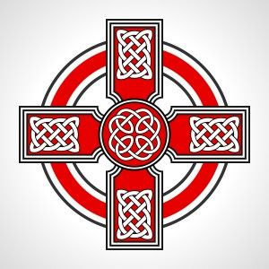
Celtic Art

Slide 3
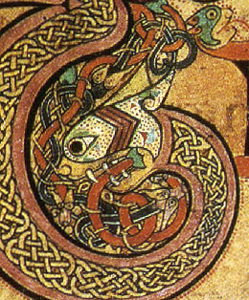
The Book of Kells
Trinity College
Dublin

Slide 4
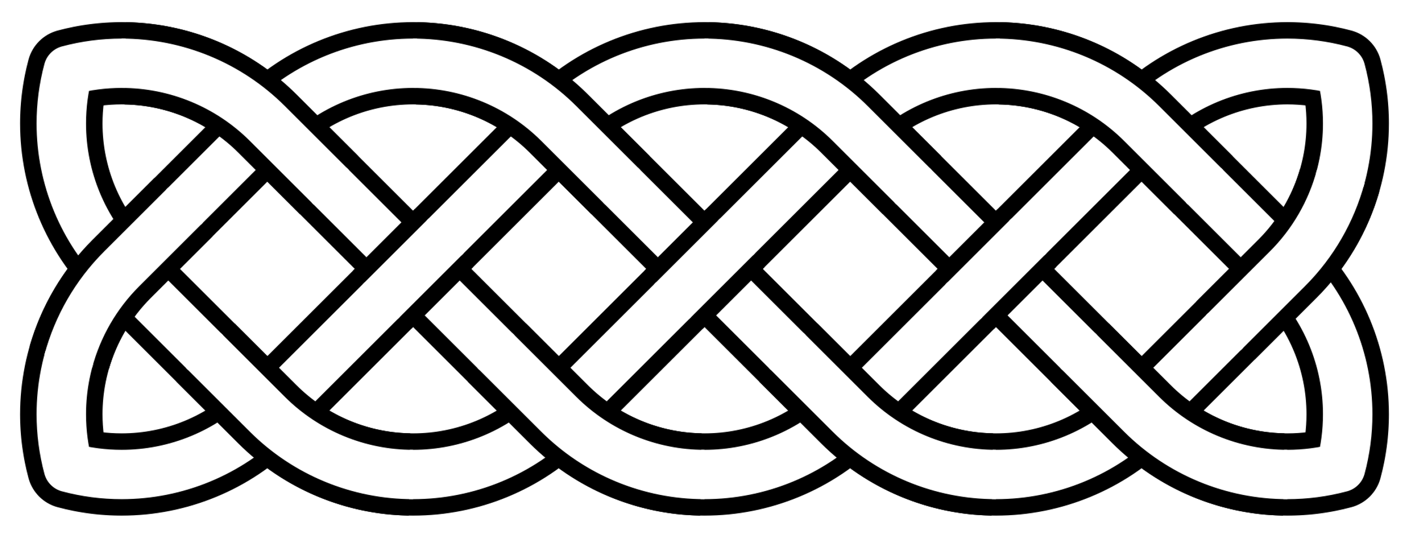
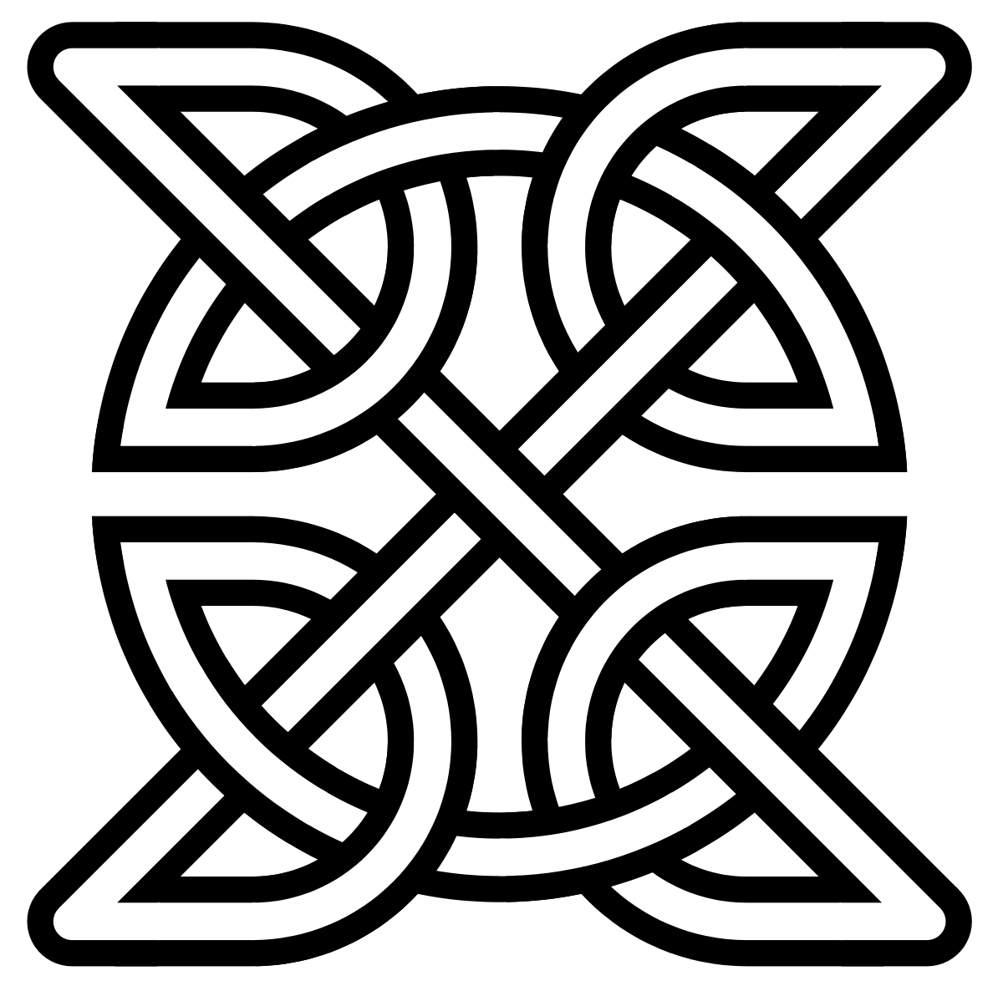
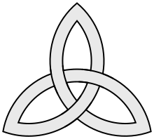

Slide 5
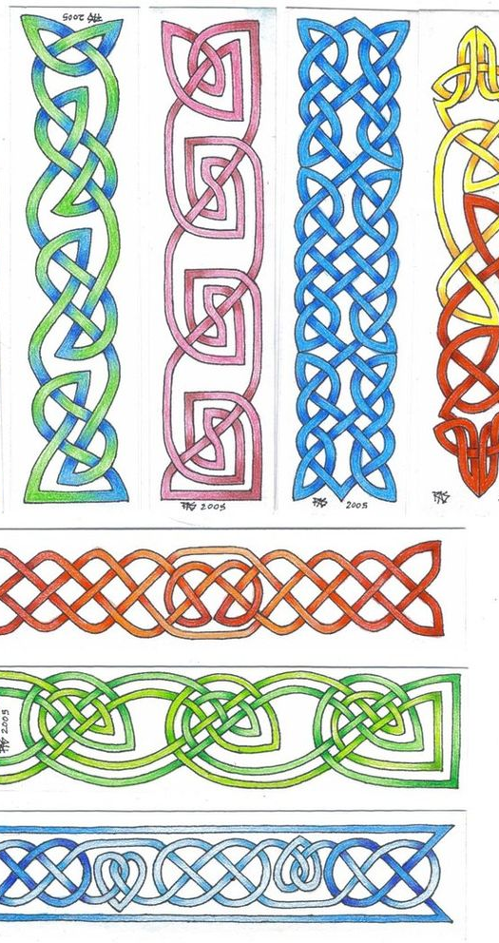
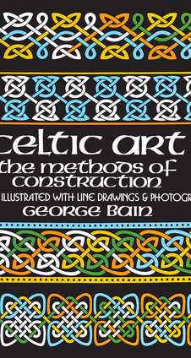

Slide 6
How to draw simple Celtic Knots
Start with a grid
(5 , 4) grid

Slide 7
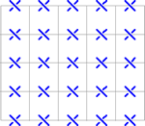
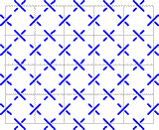
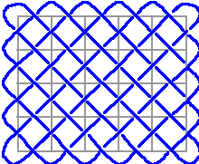
(5,6) Celtic Knot

Slide 8
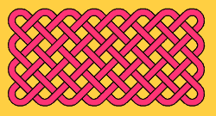
(4,8) Celtic Knot
How many pieces of string are needed?

Slide 9
How many pieces of string are needed?
(2,2) | 2
(3,2) | 1
(5,3) | 1
(4,4) | 4

Slide 10
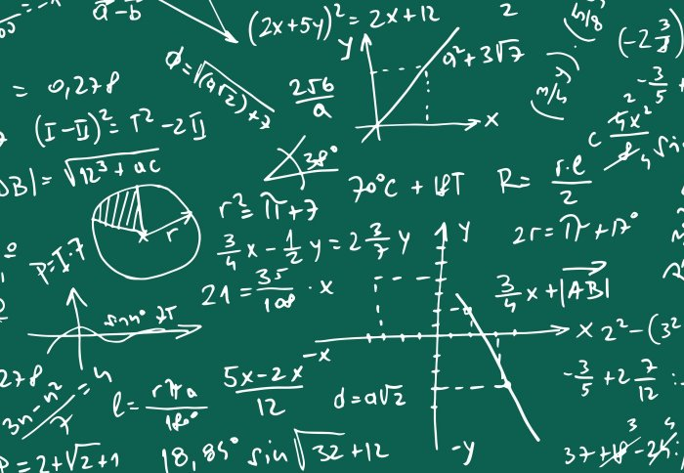
The mathematical method
Do lots of experiments
Look for patterns
Make a hypothesis
Check your hypothesis with other examples
Prove your result using mathematical reasoning

Slide 11
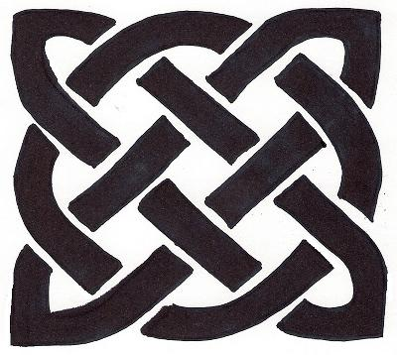
Number of strings = gcd(m,n)
gcd(5,4) = 1
gcd(7,8) = 1
gcd(2,2) = 2
gcd(4,8) = 4
gcd(3,3) = 3
Prove using a geometrical version of Euclid’s algorithm

Slide 12
gcd(m,n)
(2,3) =
(4,7) =
(4,12) =
(27, 99) =

Slide 13
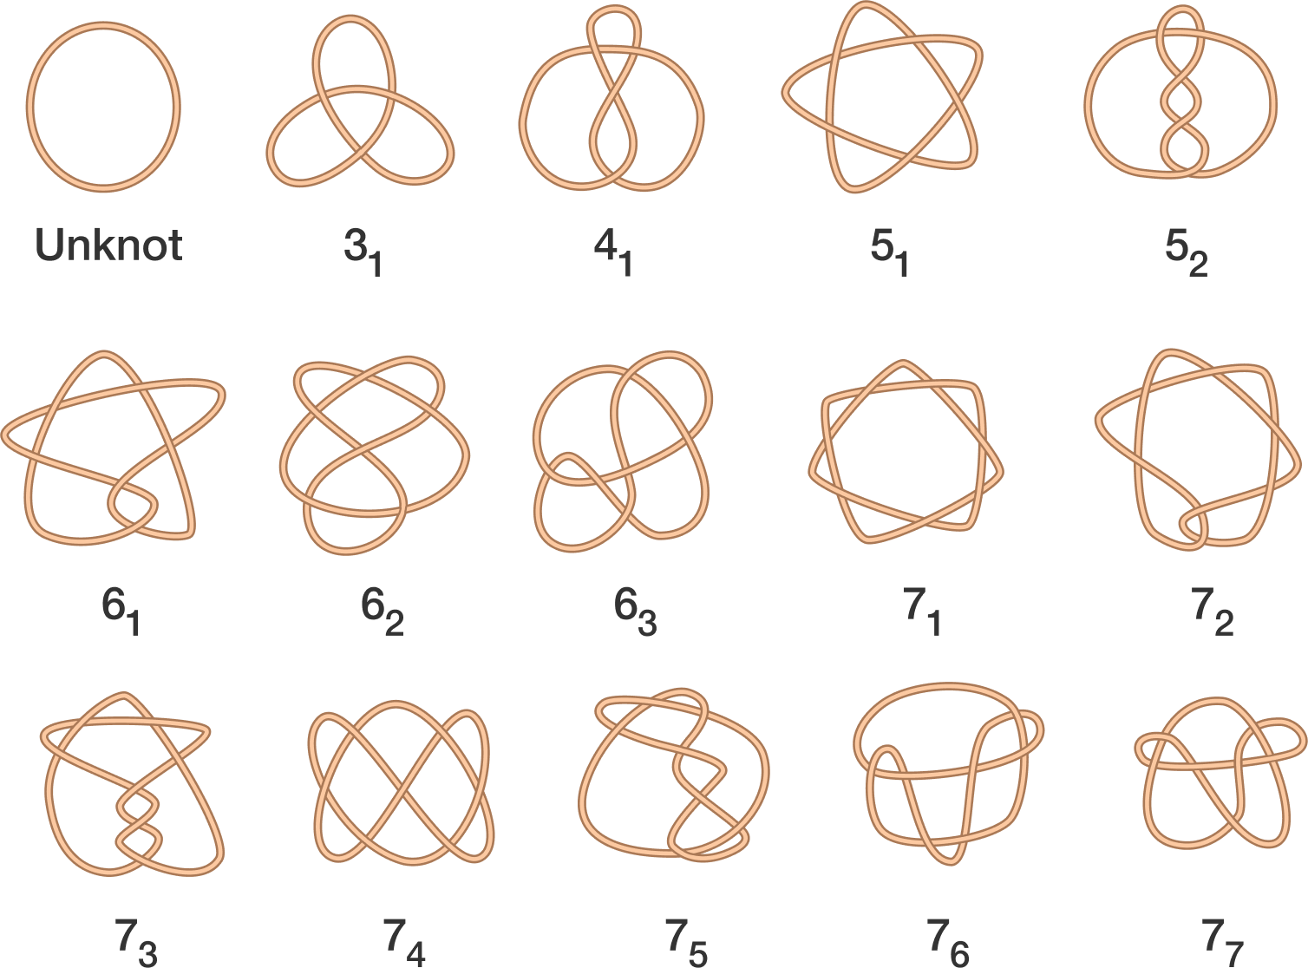
All knots with up to seven crossings

Slide 14
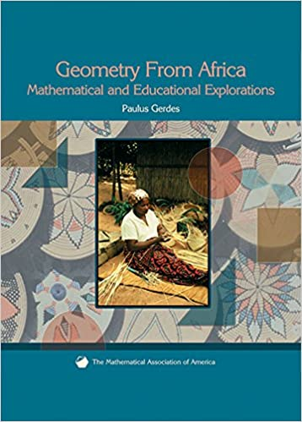

Slide 15
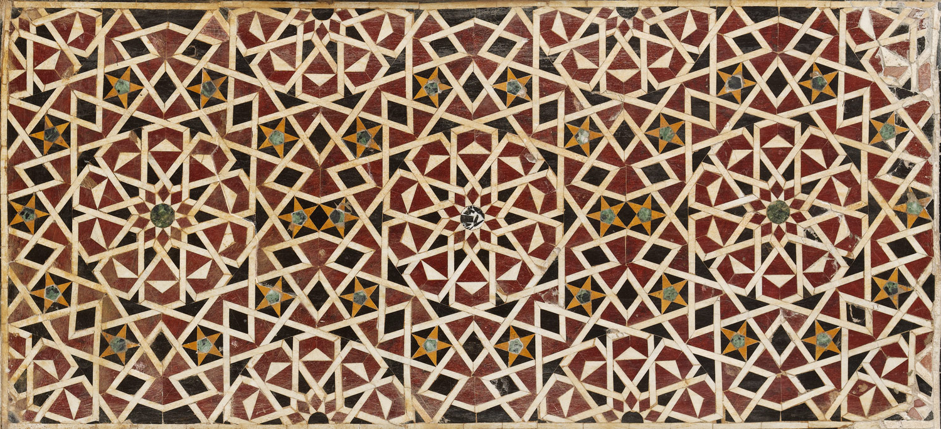
Islamic Art

Slide 16
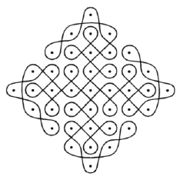
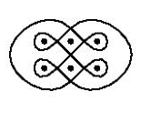
Plaited Mat Sona Art

Slide 17
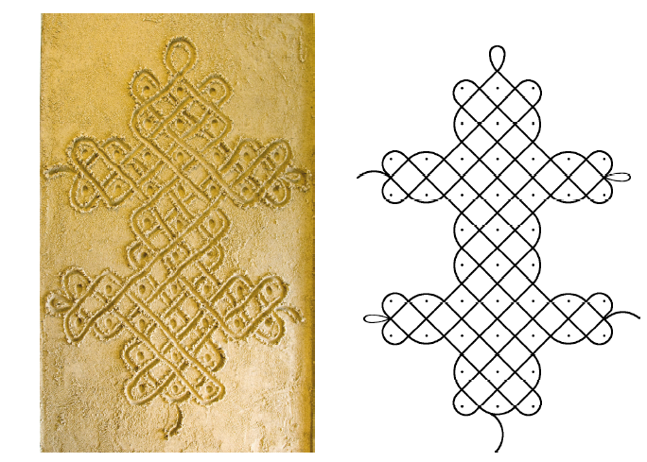

Slide 18
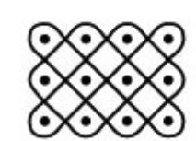
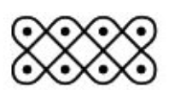
(3,4)
(2,4)
Number of loops is gcd(m,n) as before

Slide 20
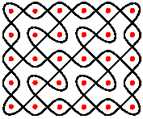
Chased Chicken

Slide 21
